Slide 1

Telecom Churn Analysis
Team Python Thinkers

Slide 2
Team members
Anto Francis (C0825095)
Omer Volkan (C0831373)
Rupesh Chandran (C0826779)
Sachin Sreekumar (C0825096)

Slide 3
Introduction
Customers are rapidly changing to better services
Churning is the process of stop using the service of a provider.
Service Providers should be able to tackle competition by reducing churn rate.
Monthly churn rate – 2%. Could increase to 60% in coming years.
Motive of this project – Identify the parameters to detect churning, create and compare machine learning models to predict churning

Slide 4
About Dataset
Dataset from Kaggle - https://www.kaggle.com/code/umashankarsomaskar/telecom-churn-pca-rf-hyper-pram-tune/data
Data belongs to users in South-East part of Asia
Features includes all the information such as Total Recharge Done, Total Calling and Data Usages, etc., for the months of June-September
Has 99999 Records and 226 Features
Dataset doesn’t come with target feature

Slide 5
Data preprocessing

Slide 6
Feature selection & extraction
Selected all premium customers from the dataset
Premium customers – Those who spend more than 70 percentile of the average amount in first two months
New fields were created for each months which shows the total amount spent by the customer. Summed up internet usage charges and Call/SMS charges.
Dropped the individual columns which shows internet, call charges

Slide 7
Feature selection & extraction (Continued…)
Created target column “is_churn” for classification
“is_churn” column was set by seeing whether customer who was using the service before stopped spending money in September.
“is_churn” shows 1 if customer is churning, otherwise 0
Finally, we calculated average of June and July data and removed unnecessary columns.

Slide 8
data cleaning
Removed columns which has more than 40% null values
Deleted few records with null values in them
Removed few columns which has only one unique value in them as it doesn’t add any value to the model
Checked the correlation matrix, and removed some columns with high correlation
Changed data type of some fields for consistency

Slide 9
Dataset before Preprocessing 99999 x 226
Dataset after Preprocessing 28000 x 62

Slide 10
Exploratory data analysis

Slide 11
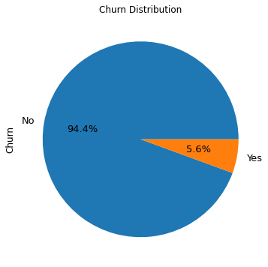
Proportion of churn
Used is_churn feature to determine the percentage proportion of churn
Insight:
Percentage of premium users churning is very less, which is not bad for the provider.

Slide 12
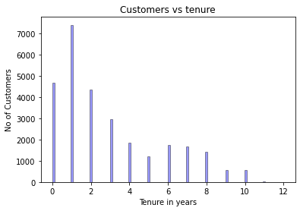
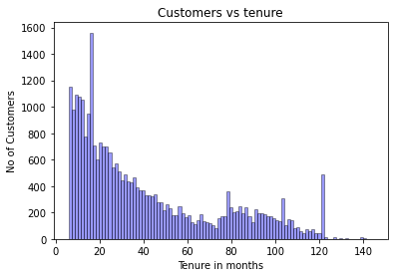
Customer tenure
For each customer, calculated the duration in which they have been using the service.
Insights:
Most of customers are new
Majority of the customers have been using it less than 5 years
Monthly graph clearly shows that customers gradually decreasing in coming months.

Slide 13
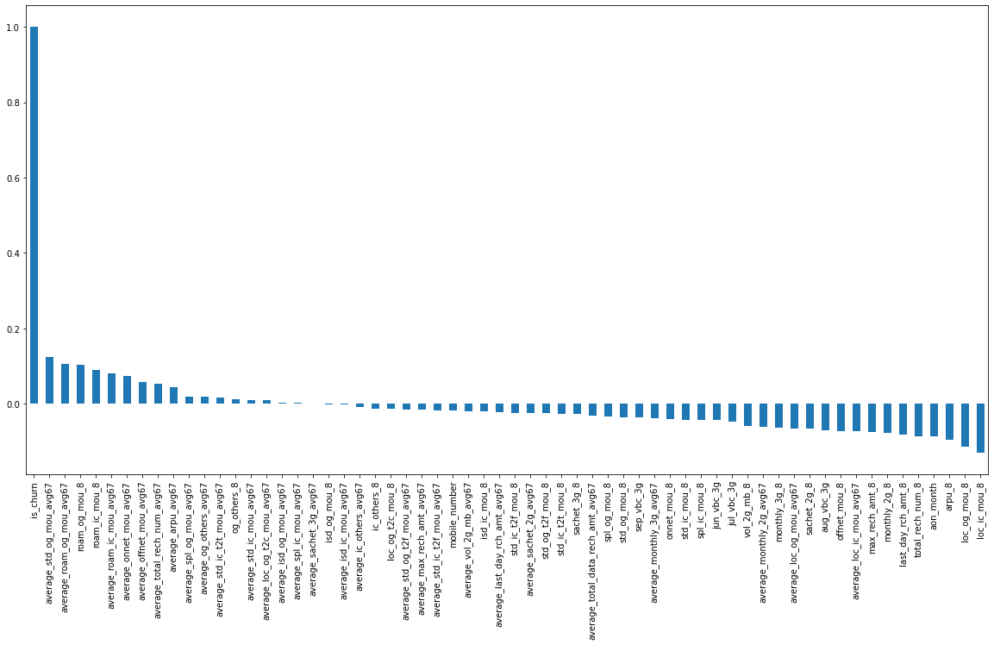
Churn dependency
Analysis shows that features such as maximum recharge amount, revenue from customers, and Standard Outgoing calls are some of the important indicators of churning.

Slide 14
Model creation and comparison

Slide 15
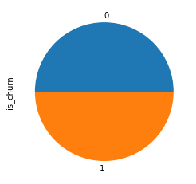
Data preparation
Used SMOTE library function to oversample the dataset in order to eliminate bias.
Divided the dataset into 70% train and 30% test data

Slide 16
Classification models
Support Vector Classifier
Logistic Regression
Random Forest Classifier

Slide 17
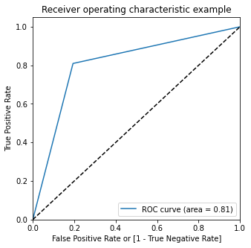
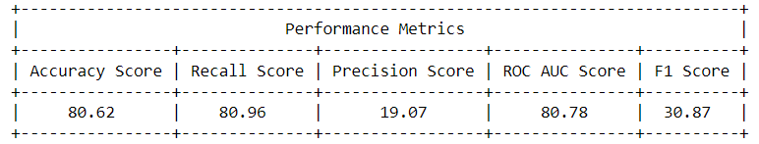
Support vector classifier

Slide 18
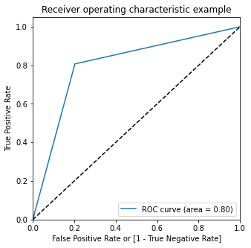
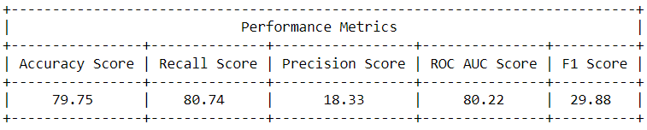
Logistic regression
Used PCA for feature elimination before fitting the model
The accuracy is somewhat like SVC

Slide 19
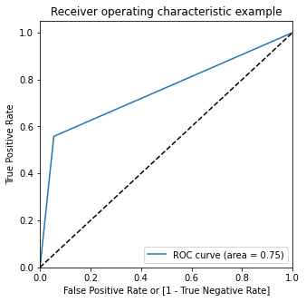
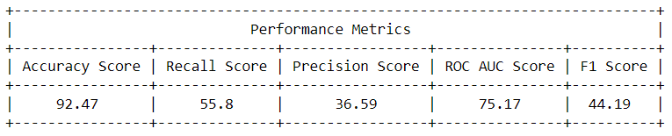
Random forest classifier
Using default parameters
Accuracy and precision increased but Recall reduced

Slide 20
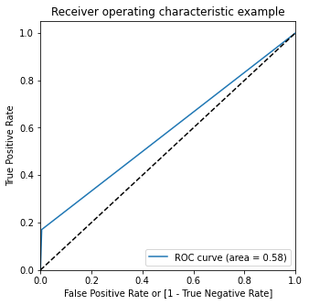
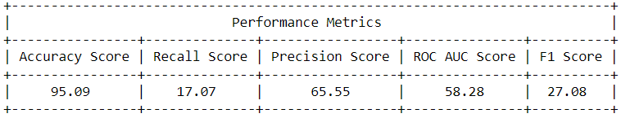
Random forest classifier
After hyperparameter tuning using GridSearchCV and Kfold=3
Accuracy and precision increased but Recall and ROC score reduced sharply

Slide 21
Summary
SVC has the highest accuracy, however its precision is comparatively low
Logistic Regression has almost same but lesser performance than SVC, so not recommended
Random Forest Classifier using the default parameters shows moderate performance in F1 score and shows high accuracy.
After hyperparameter tuning, RFC increased its accuracy. However, all other metrics fell rapidly. So not recommended for prediction.
SVC or RFC using default hyperparameters is the best model to choose in this scenario.

Slide 22
Conclusion
Developed various insights from the telecom dataset
Created models of 80-95% accuracy
Telecom services can make use of these insights to identify and predict churning.

Slide 23
Thank you

